Slide 1

A Targeted Look: Regional and County-Level Justice System Trends
Presentation to the Juvenile Justice
Advisory Group
Emily Dattilio
Office of Justice Research and Performance
October 2, 2024
Notes:
Cover Slide

Slide 2
Introduction:
This presentation will lead to a conversation about the Request for Proposals (RFP) for the Transformative Youth Justice Hubs that were approved at the June quarterly meeting
As a reminder, the JJAG authorized funding of up to $4 million to create four Transformative Youth Justice Hubs:
Two urban and two rural Hubs will be created to operate as partnerships to coordinate and provide support to youth and families at prevention and re-entry points
Hubs will maintain a lead fiscal partner and coordinating partner, and a board with co-chairs of different backgrounds
Partnerships will provide prevention support services that center youth well-being domains with a specific priority towards adolescent age youth
Hubs will be closely connected with the YJI, which will provide support through its new YFACTS Center

Slide 3
Overview and Goals:
Examine four select regions and counties
Inform Conversations on the formation of the Transformative Youth Justice Hubs
    Youth population and demographics
Socioeconomic indicators of select geographic areas
Examine Youth Justice System Data
Differences in System Trends and Type of Cases Across Regions
Differences in Local Practice, especially around diversion (adjustment)
Differences in outcomes by race in youth justice data

Slide 4
Demographics and Socioeconomic Factors
Notes:
Section Slide

Slide 5
Youth Population: Urban, Suburban, and Rural
Youth Population Age 7-17
300 sq mi
2,860 sq mi
1,200 sq mi
6,260 sq mi

Slide 6
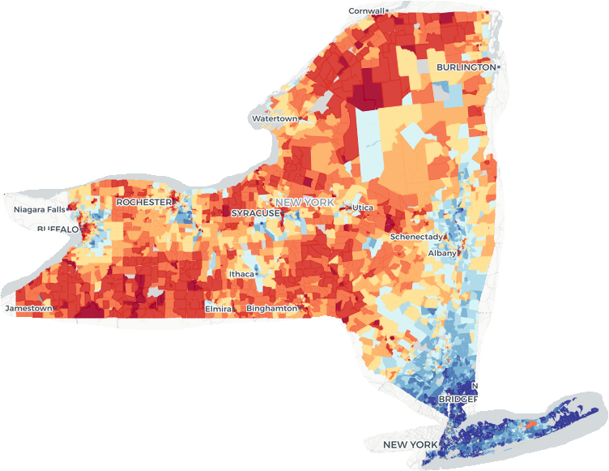
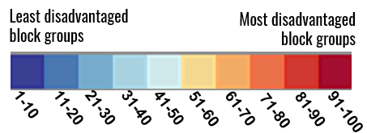
Area Deprivation Index (ADI): Ranks Neighborhood by Socioeconomic Disadvantage Using 17 Census Indicators
→Educational Attainment
→Median Income
→Unemployment Rate
→ Poverty Rate
→ Single Parent Households
→ Home values and ownership
→ And more!
Area Deprivation Index, Center for Health Disparities Research, University of Wisconsin School of Medicine and Public Health: https://www.neighborhoodatlas.medicine.wisc.edu/

Slide 7
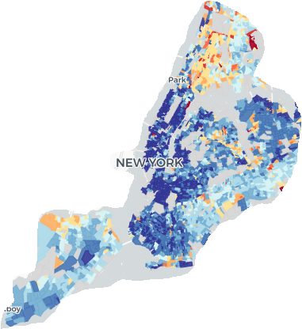
Area Deprivation Index in NYC

Slide 8
Youth Population: Southern Tier
Youth Population Age 7-17

Slide 9
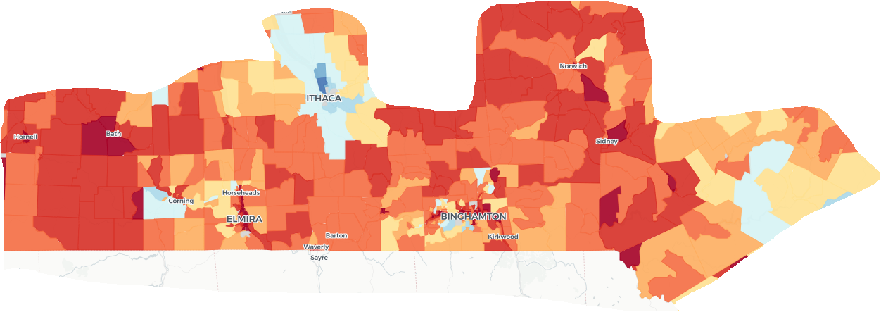
Southern Tier – Areas of Deprivation
6,260 square miles
636,020 Total Pop
118,774 (19%) Under 18
8 Counties:

Slide 10
Youth Population: Erie County
Youth Population Age 7-17

Slide 11
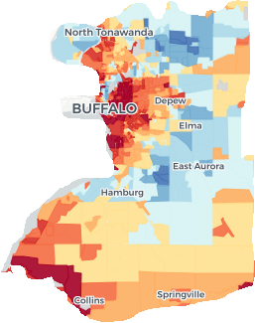
Erie County Areas of Deprivation
1,227 square miles
951,232 Total Pop
190,577 (20%) Under 18

Slide 12
Youth Population: Long Island
Youth Population Age 7-17

Slide 13
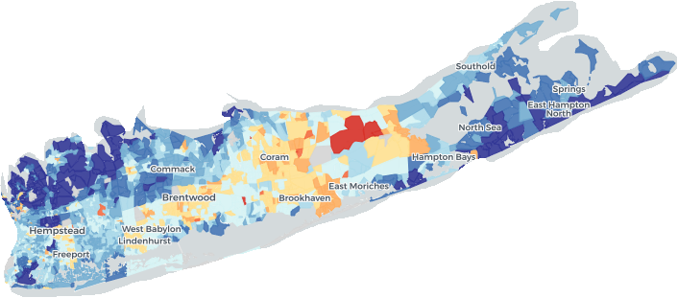

Long Island– Areas of Deprivation
2,826 square miles
2.9 Million Total Pop
612,384 (21%) Under 18

Slide 14
Youth Population: NYC
Youth Population Age 7-17

Slide 15
Area Deprivation Index in NYC
302 square miles
8.6 Million Total Pop
1.7 Million (20%) Under 18

Slide 16
Other Census Indicators
Census Indicator | New York City | Long Island | Erie County | Southern Tier*
Population Under 18 | 1,762,827 | 612,384 | 190,577 | 118,774
% of Children in Poverty Last 12 Months | 23% | 7% | 19% | 19%
% of Children Living in HH Receiving Public Assistance | 35% | 10% | 30% | 27%
% of Children Living with One Parent** | 39% | 21% | 35% | 36%
Public School Enrollment | 79% | 87% | 86% | 90%
Less than High School Degree (population age 25+) | 17% | 9% | 8% | 9%
Source: U.S. Census Bureau (2023). Children Characteristics, 2018-2022 American Community Survey 5-year estimates.
*Except for Population Under 18, Schuyler County is not available and not included in the statistics for Southern Tier
**Other non-spouse adults may live in the home

Slide 17
Juvenile Justice System Data
Notes:
Section Slide

Slide 18
18
Juvenile Delinquency
Arrests
(Felony & Misdemeanor)
Family Court Petition
JD Finding
Dismissal/No Finding
Placement
Probation
Conditional Discharge
Probation Intake
Adjustment Diversion
Juvenile Justice System Points
18
One Goal of the Youth Justice Hubs:
Establish relationship with law enforcement agencies and the court system to support diversion services

Slide 19
Probation Intake Trends
Notes:
Section Slide

Slide 20

Larger Increase in Probation Intakes on Long Island
Probation Juvenile Delinquency Intakes
Southern Tier
8 Counties, 6,200 sq. miles 42,470 Youth Ages 12-17
150 Intakes Per 10,000 pop.
Erie County
1 County, 1,200 sq. miles
65,300 Youth Ages 12-17
96 Intakes Per 10,000 pop.
Long Island
2 Counties, 2,800 sq. miles
220,500 Youth Ages 12-17
52 Intakes Per 10,000 pop.

Slide 21
More felony-level intakes in NYC
Probation Juvenile Delinquency Intakes
Long Island
2 Counties, 2,800 sq. miles
220,500 Youth Ages 12-17
52 Intakes Per 10,000 pop.
New York City
5 Counties, 300 sq. miles
548,800 Youth Ages 12-17
130 Intakes Per 10,000 pop.

Slide 22

Black Children Have 2nd Highest Volume & Highest Rate
Southern Tier
Note: Intakes include cases of individuals ages 12-17

Slide 23
Black Children Have Highest Volume and Rate
Erie County
Note: Intakes include cases of individuals ages 12-17

Slide 24
Black Children Have Highest Volume and Rate
Long Island
Note: Intakes include cases of individuals ages 12-17

Slide 25
Black Children Have Highest Volume and Rate
NYC
Note: Intakes include cases of individuals ages 12-17

Slide 26
Probation Adjustment Trends
Notes:
Section Slide

Slide 27
Adjustment Rates Differ Across Regions/Counties

Slide 28
Adjustment Rates Vary Across Counties
Probation Adjustment Rates

Slide 29
Large Difference in Adjustment Rate in Nassau & Suffolk
Probation Adjustment Rates

Slide 30
30
Juvenile Delinquency
Arrests
(Felony & Misdemeanor)
Family Court Petition
JD Finding
Dismissal/No Finding
Placement
Probation
Conditional Discharge
Probation Intake
Adjustment Diversion
Juvenile Justice System Points
30
Presentment Agency: Declines to File a Petition

Slide 31
Diversion May be Occurring at Different Points in System
2023 Probation Intakes Referred for Family Court Petition versus Number of Petitions
Erie County
Intakes: Petitions
Long Island
Intakes: Petitions
NYC
Intakes: Petitions
Southern Tier
Intakes: Petitions
460
330
308
459
547
508
5,664
1,451

Slide 32
Probation Adjustment by Race/Ethnicity
Notes:
Section Slide

Slide 33
Black and Hispanic Youth: Less Likely to be Diverted
Probation Outcomes: 2023

Slide 34

Black and Hispanic Youth: Less Likely to be Diverted

Slide 35
Black and Hispanic Youth: Less Likely to be Diverted

Slide 36
Family Court Juvenile Delinquency Petitions
And Outcomes
Notes:
Section Slide

Slide 37

Family Court Petitions: Severity of Charges Varies

Slide 38
Family Court Petitions: Severity of Charges Varies

Slide 39
Less Than 50%Family Court Petition Result in Juv. Del. Finding;
Opportunity to Increase Adjustment Rate

Slide 40
Family Court Outcomes by Race/Ethnicity
Notes:
Section Slide

Slide 41
Family Court JD Petitions Resulting in JD Finding
NYC
Long Island
Higher % JD Finding in Long Island vs NYC

Slide 42
Family Court JD Petitions Resulting in JD Finding
Erie County
Southern Tier

Slide 43
Key Takeaways:
Demographic, Socioeconomic, and Geographic Considerations
Demographic makeup looks very different across the state
Rural areas will have relatively small youth populations that cover thousands of square miles
Counties such as Erie serve children and families living in both highly urban and rural areas
Geographic areas of deprivation (low income, lack of resources) exist in both urban and rural areas and that level of deprivation varies across the state
Justice System Considerations
Practices of local counties may look very different, even when they are right next door
Diversion may be happening at different points in the system
Racial disparities exist in urban as well as rural counties

Slide 44
Data Sources:
Youth Population and Demographics: U.S. Census Bureau (Slides 5 , 8, 10, 12)
Area Deprivation Index, Center for Health Disparities Research, University of Wisconsin School of Medicine and Public Health: https://www.neighborhoodatlas.medicine.wisc.edu/ (Slides 6, 7, 9, 11, 13, 15)
Census Indicators: U.S. Census Bureau (2023). Children Characteristics, 2018-2022 American Community Survey 5-Year Estimates (Slide 16)
Juvenile Delinquency Probation Intakes: Caseload Explorer Database as of 8/15/2024 (Slides 20-35)
Family Court Petitions: NYS DCJS-OCA Family Court Database as of 8/15/2024 (Slides 37-42)

Slide 45
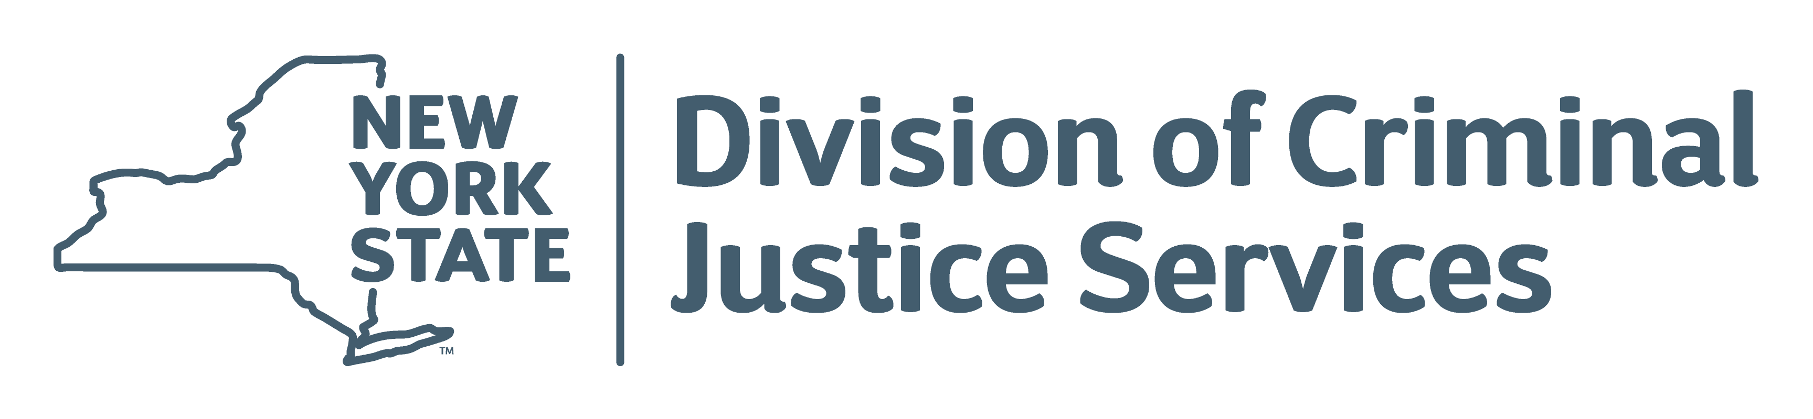
Notes:
End slide

